Slide 1

College Database management system
Presented by:
Kurla Hari Viswanadh
Reg no:37110396
Guided by:
Dr .A. Viji Amutha Mary
M.TECH., Ph.D

Slide 2
Outline
Introduction
Objective
Scope of the project
Software configuration
System
Architecture
Module Implementation
Application Snapshots
Future Enhancement
Conclusion
References

Slide 3
Introduction
Providing information to all the levels of management within an organization / institution
It is required to Design of Computerized Management System, to speed up and make it easy to use system.
It reduces the manpower needed to perform the entire admission and administration task by reducing the paper works needed.
The main goal of the system is to automate the process carried out in the organization with improved performance and realize the vision of complete paperless work.
Authorized Users :- Staff ( Technical / Nontechnical),Admin
Requirements for Authentication :- Register by using “Login ID” & “Password”

Slide 4
Scope of the project
The requirement of the user is to
Access / Search information.
Login to the system through the first page of the application.
Change the password after logging into the system.
View / change his / her details.
Can get help through the ‘HELP’ option to view different features of the system.
Students can give feedback on college / staff / any other student.
An admin login should be present who can read as well as remove any uploads.

Slide 5
objective
The objective of this project is to develop a Web based platform , user friendly and which can be fit into any college system.
It will remove data redundancy and will be fast in operation.
Purpose:
Its purpose is to centralize the whole system of the department. We are attempting to improve our existing system that basically runs on pen and papers or in a system which is not centralized.
The main goal of the system is to automate the process carried out in the organization with improved performance and realize the vision of paperless works.

Slide 6
2. Scope:
It is more efficient and convenient for the colleges.
It reduces the manpower needed to perform the entire administration task by reducing the paper works needed.
If all the work is done by the computer there will be no chance of errors. Moreover storing and retrieving of the information is easy, so work can be done speedily and in time.
3. Need for the proposed system:
Automation for management system will use the centralized database of the whole system of the department.
Features and Benefits:
User friendly
Report are easily generated
Very less paper works
Computer operator control

Slide 7
Software configuration
Front-End :- HTML ,CSS
Database :- MySQL
Web Server :- WampServer
Devpt. Env. :- Microsoft visual studio 2017
Back-End :- php

Slide 8
architecture
System
Module Implementation

Slide 9

Architecture
College management
Admin
Staff
College information
exams
profile
Exam marks
class
staff
Classes handled
students
subject
students

Slide 10
modules
Admin
Staff
College information
Class
subject
Staff
View staff
Set Exams
View exams
View students
Profile
Class handled
Students
View students
Add marks
View marks

Slide 11
Application Snapshots

Slide 12
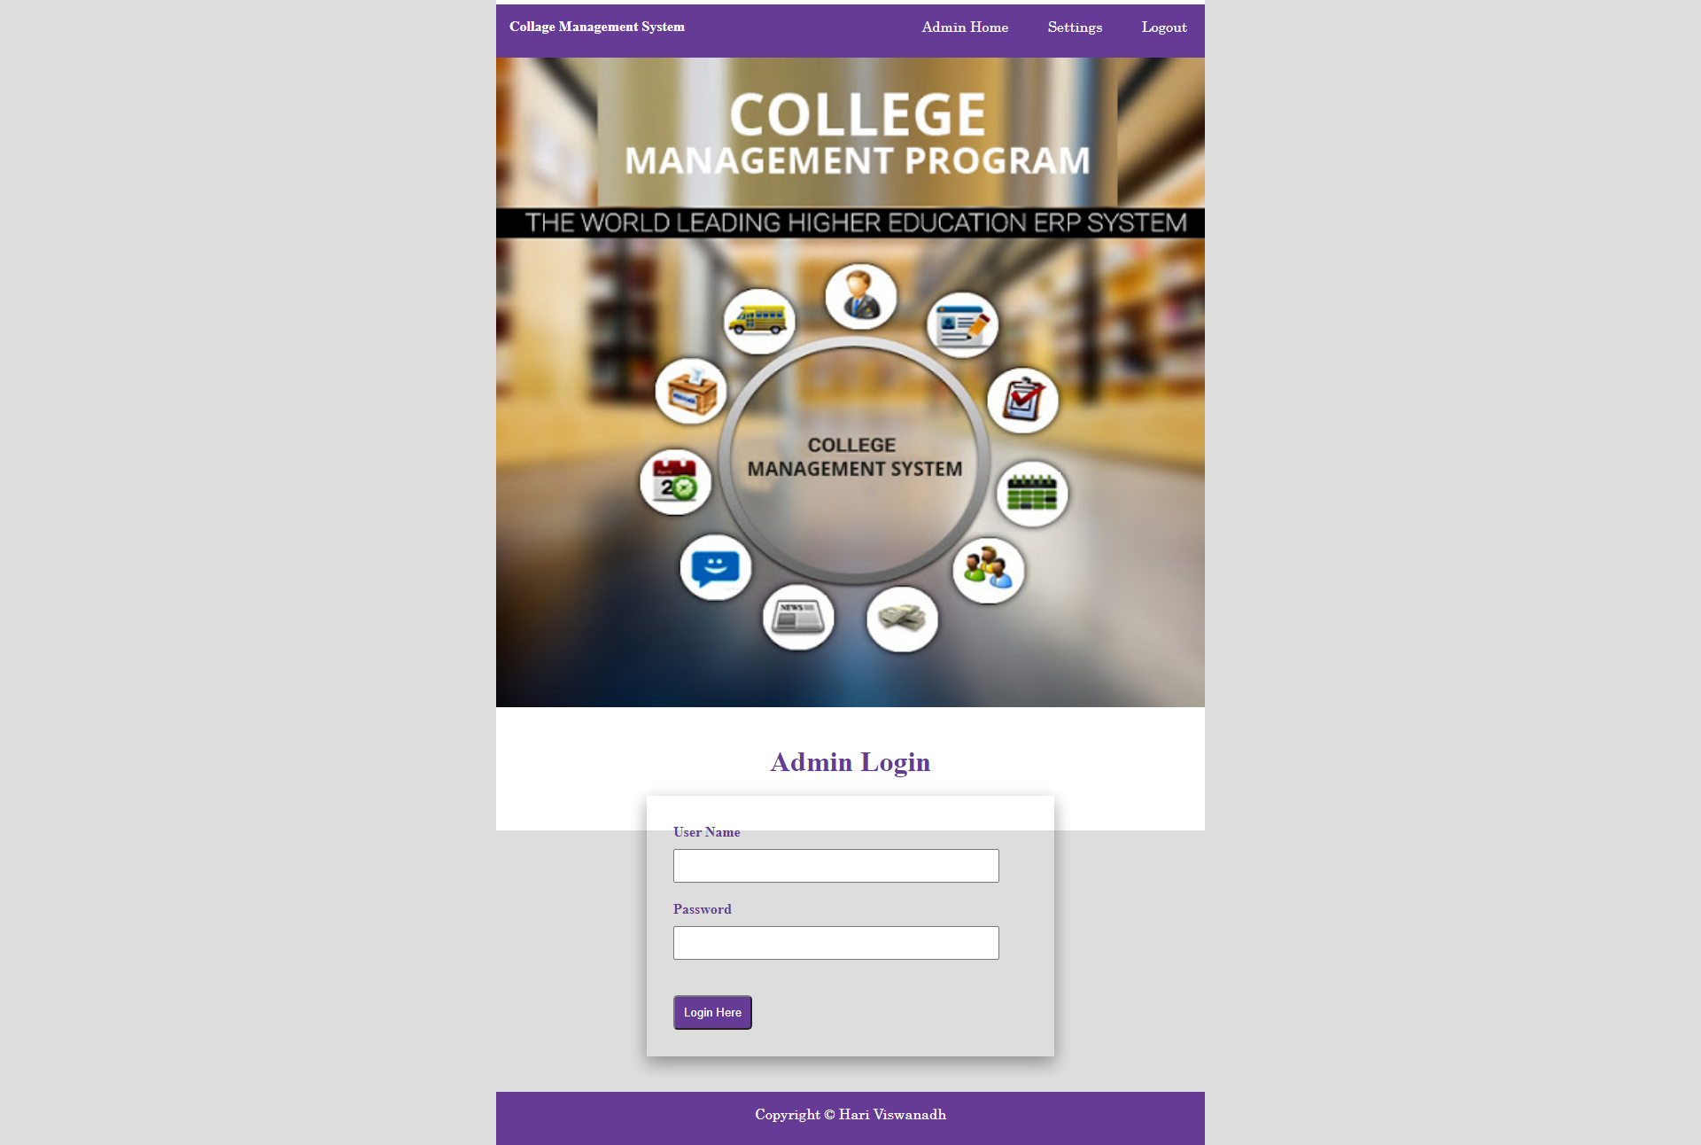
Login

Slide 13
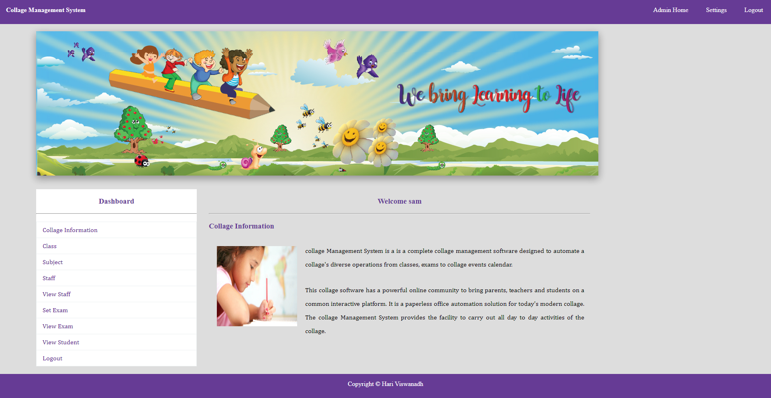
admin

Slide 14
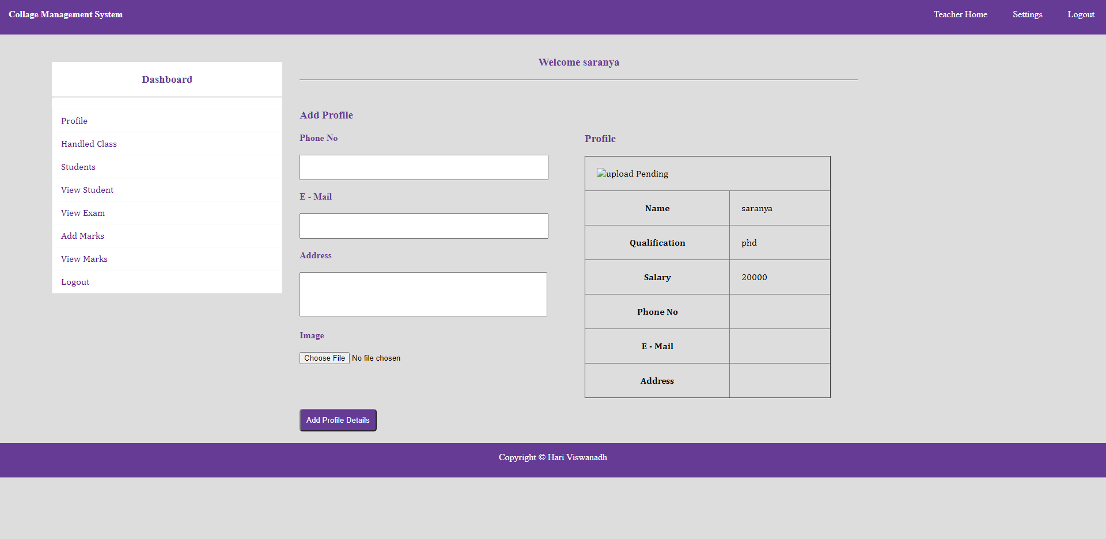
staff

Slide 15
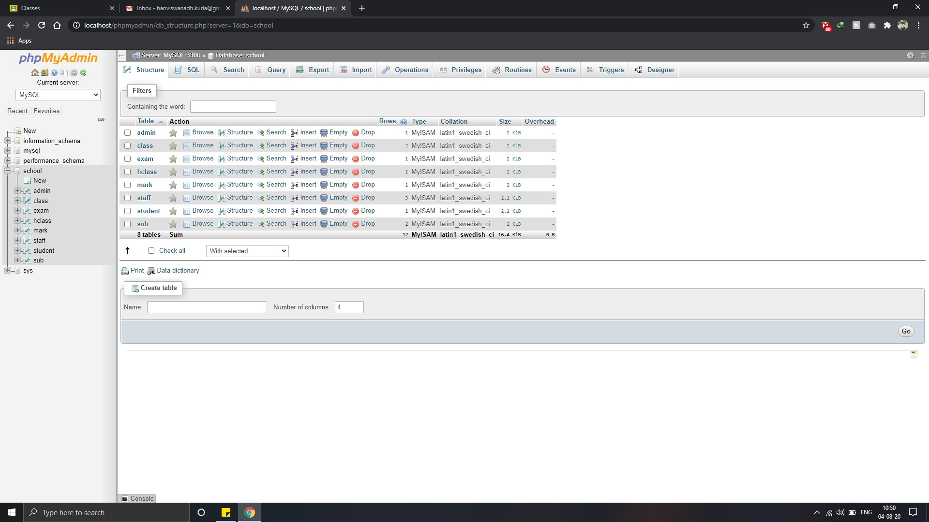
database

Slide 16
Future enhancement
Online examination module would be introduced to conduct online examination.
Further, the faculty can upload the videos of their lectures on this site and students who had missed those classes can view those videos.
Attendance facility will also be included by using face recognition

Slide 17
conclusion
The application provides appropriate information to users according to the chosen service.
The project is designed keeping in view the day to day problems faced by a college.
Deployment of our application will certainly help the college to reduce unnecessary wastage of time in personally going to each department for some information
Awareness and right information about any college is essential for both the development of student as well as faculty.

Slide 18
reference
https://www.w3schools.com/html/default.asp
https://www.javatpoint.com/phpmyadmin
https://www.coursera.org/learn/bootstrap-4/home/welcome

Slide 19
Thank you

